Slide 1
STUDENT SURVEY FORM
CLASS-20ITA8

Slide 2
AIM:-
In this project, we have created a student survey form, which will help us collect information about student field of interest, along with other details, and these details will be stored in database in form of table.
Student feedback is essential for teachers and academic institutes to improve continuously. If you work in academia, it is surely a great idea to know the perceptions and opinions of students. Educational institutes conduct surveys to gather actionable feedback from students about the institute and its faculty. Schools run surveys at the start, the middle, or the end of the academic year.

Slide 3
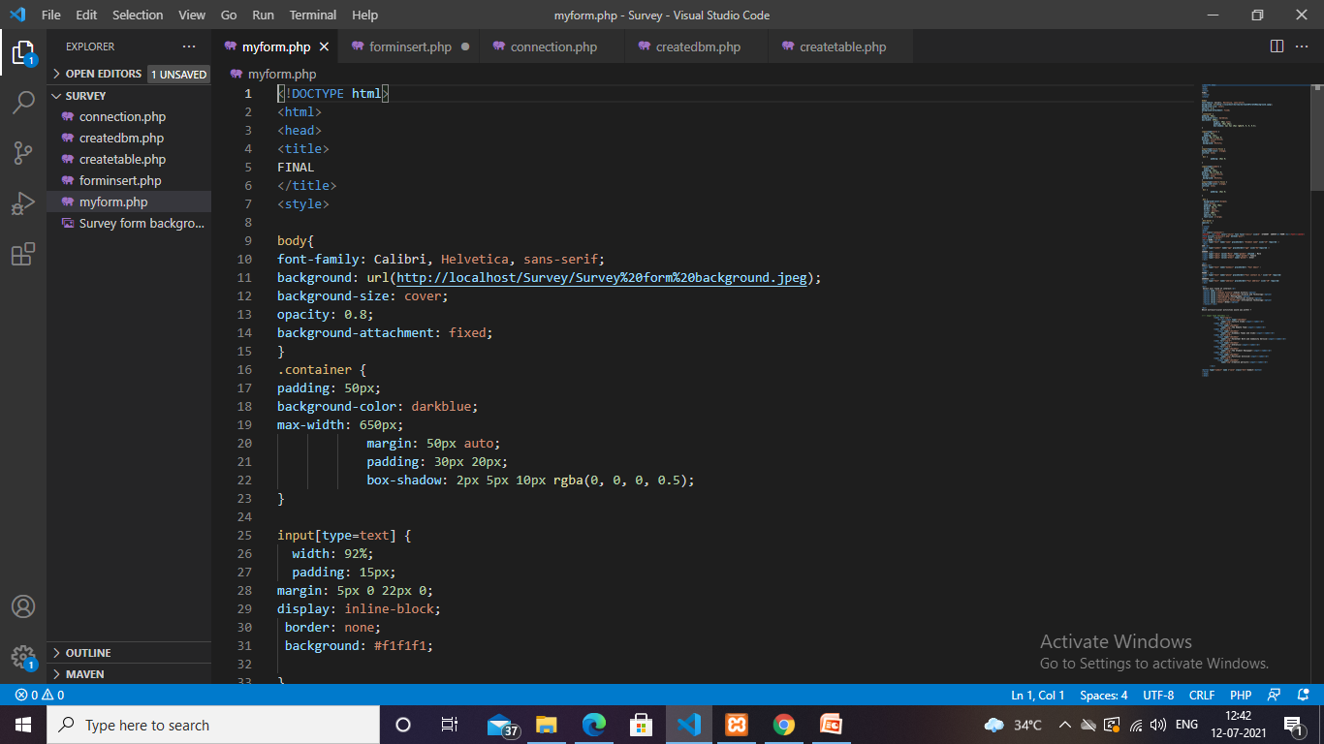
CODES:-

Slide 4
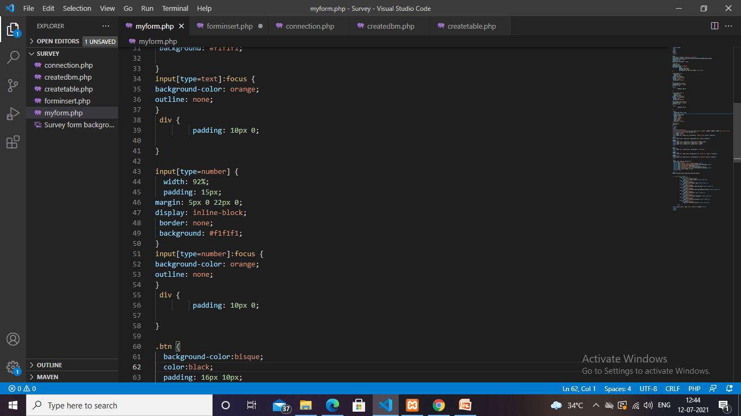

Slide 5
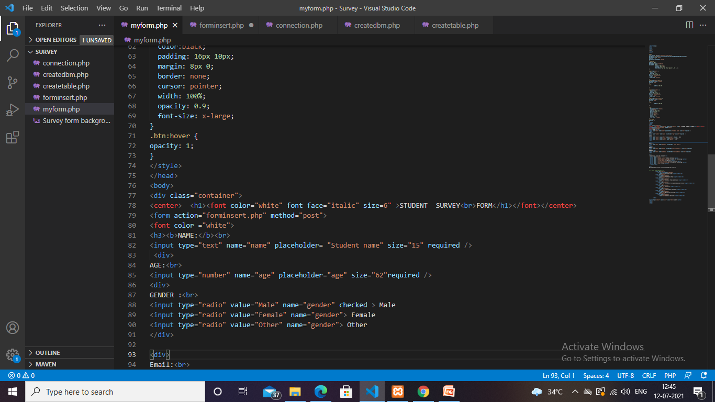

Slide 6
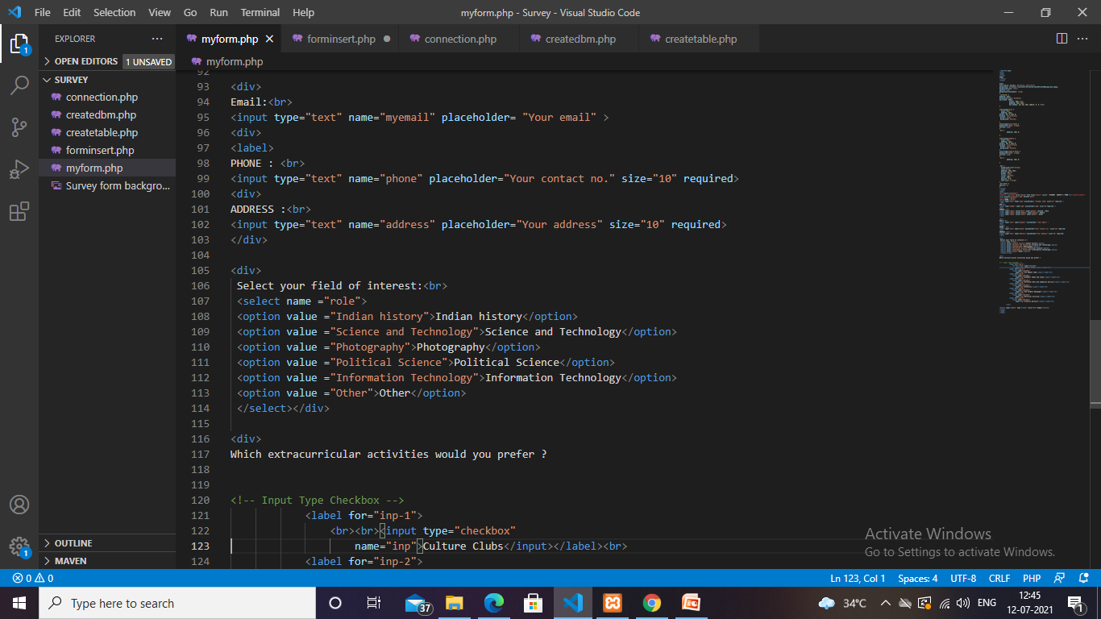

Slide 7
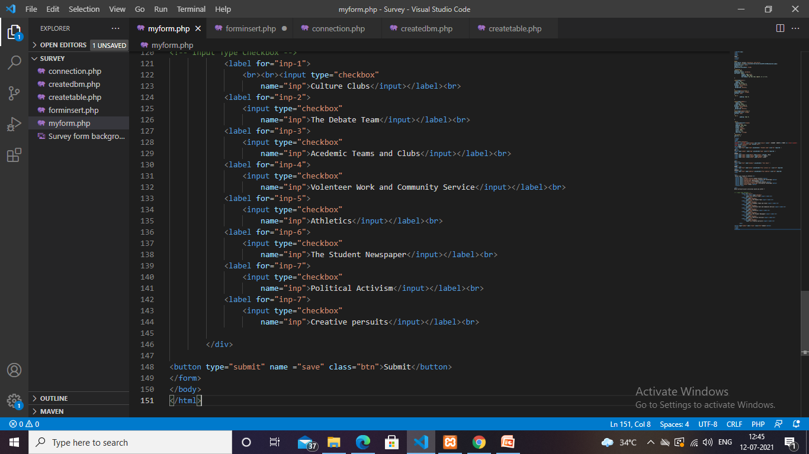

Slide 8
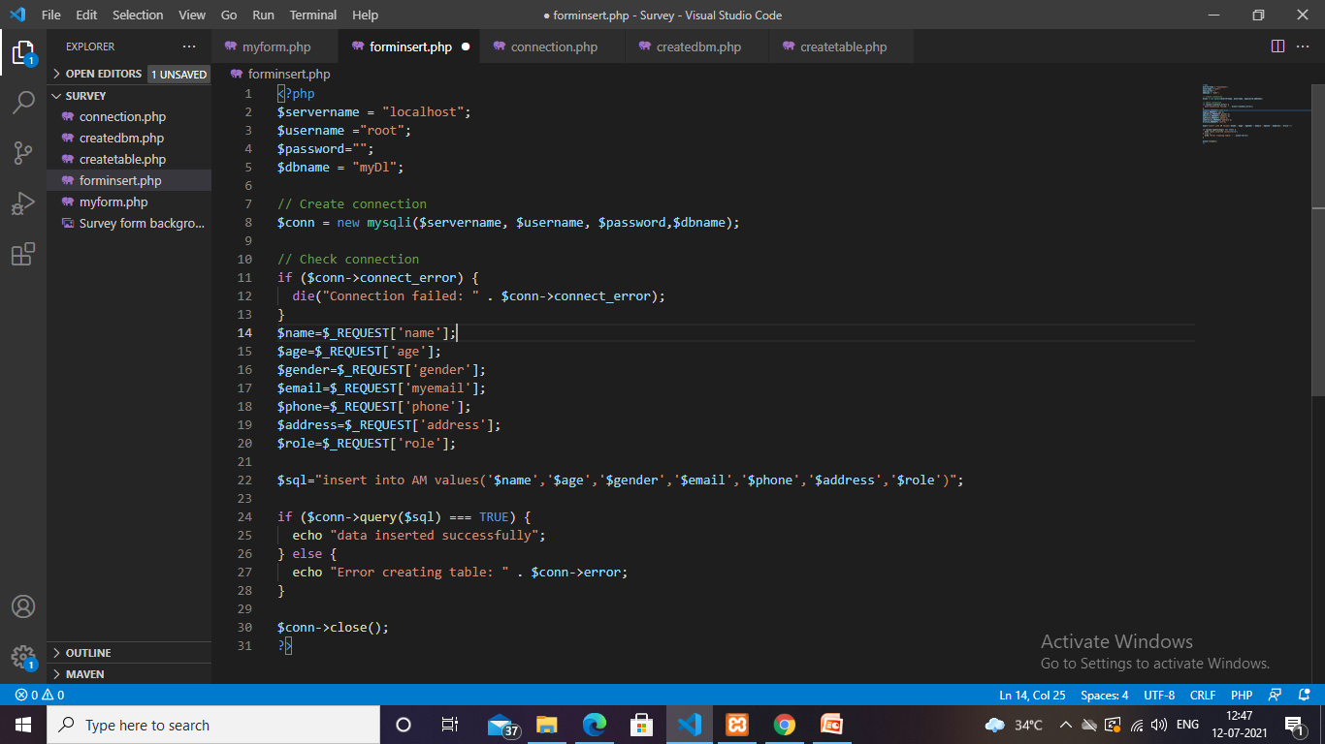

Slide 9
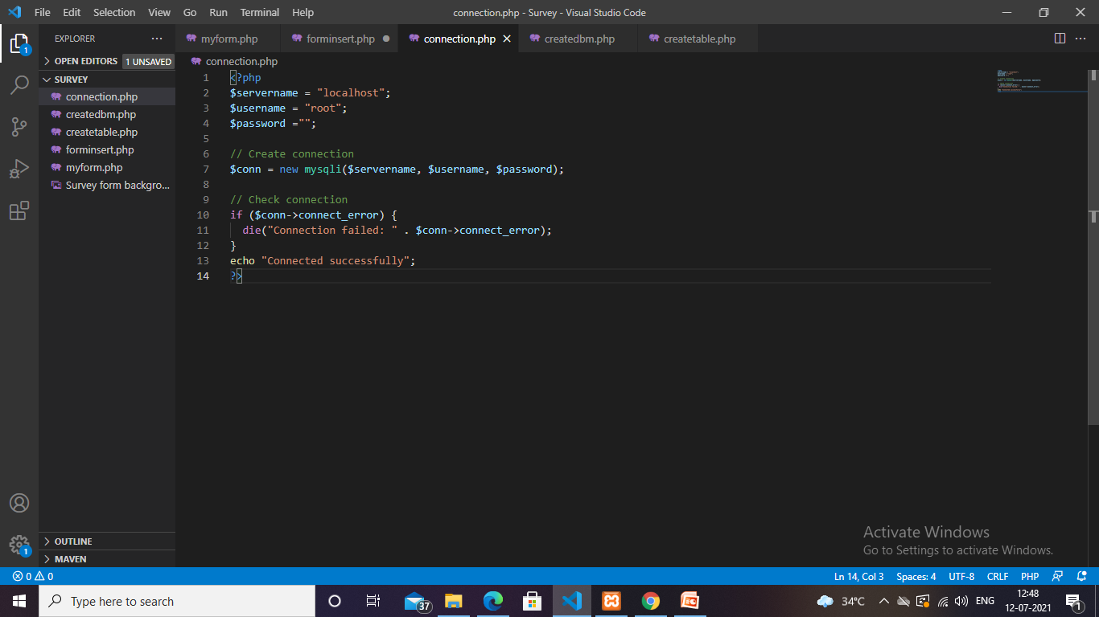

Slide 10


Slide 11
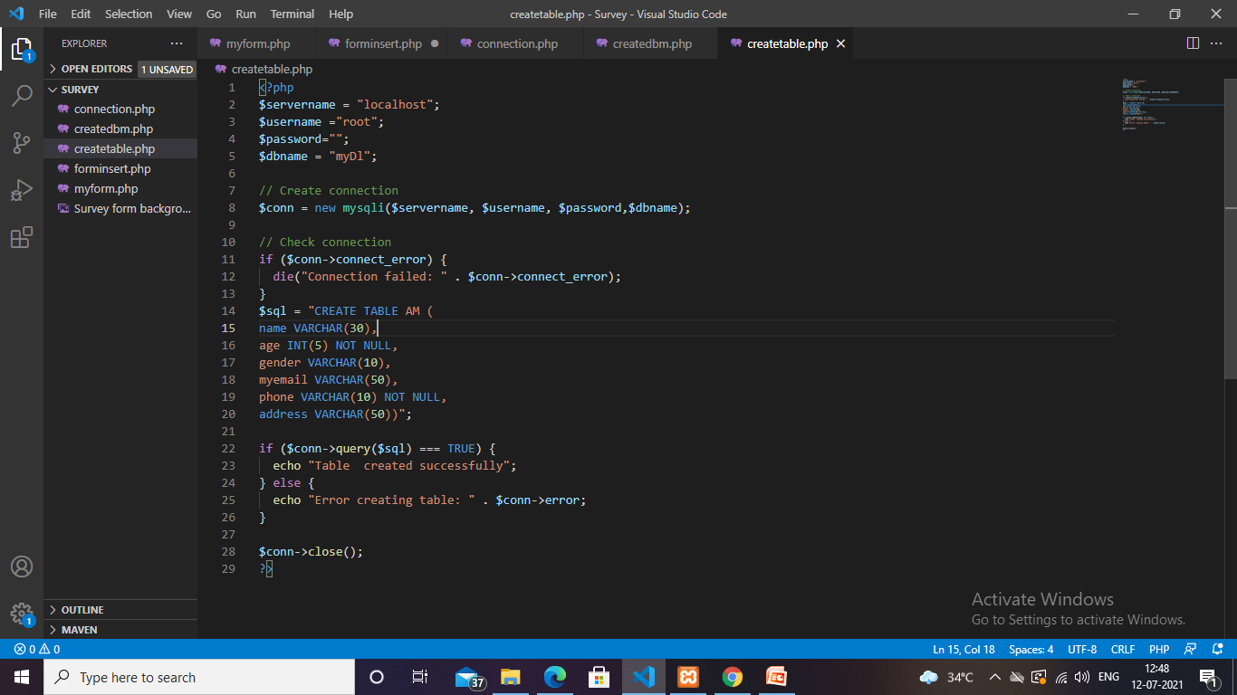

Slide 12
Explanation of Code
1-Font-family:--The font-family property specifies the font for an element. The font-family property can hold several font names as a "fallback" system. If the browser does not support the first font, it tries the next font.
2-Background URL :--For setting background.
3-Background Size:--To display background on entire page.
4-Opacity:-0.8; For adding transprency inside the background of form.
5-Background-attachment:--Fixed; It is used to specify the kind of attachment of the background image with respect to its container. It can be set to scroll or remain fixed. It can be applied to all HTML elements.
6-Container-Class selector for <div> tag.
7-Padding:--50px; To specify space between text inside <div> and border.
8-Max-Width:--700 px; For setting the width of form.

Slide 13
9-Maggin:--For setting margin.Four types:--Margin Top=100px,Margin buttom=100px,Margin right=150px,Margin left=80px.
10-Box shadow:--It will add shadow effect around the form.
11-Rgba(0,0,0,0.5):-RGBA is a type of CSS color value that allows us to set a color and also its opacity/transparency. ... RGBA is an extension of the RGB color model. The acronym stands for red green blue alpha. The alpha value represents the level of transparency/opacity of the color.
12-a-Input{type=text}
b-Width=80%
c-Padding=15px
d-Margin=5px 0 22px 0
e-Display=inline-block
f- Border=none
g-Backgroung=#f1f1f1
13-.btn:--Class selector for submit button
14-<form action=“____ .php”>

Slide 14


Slide 15
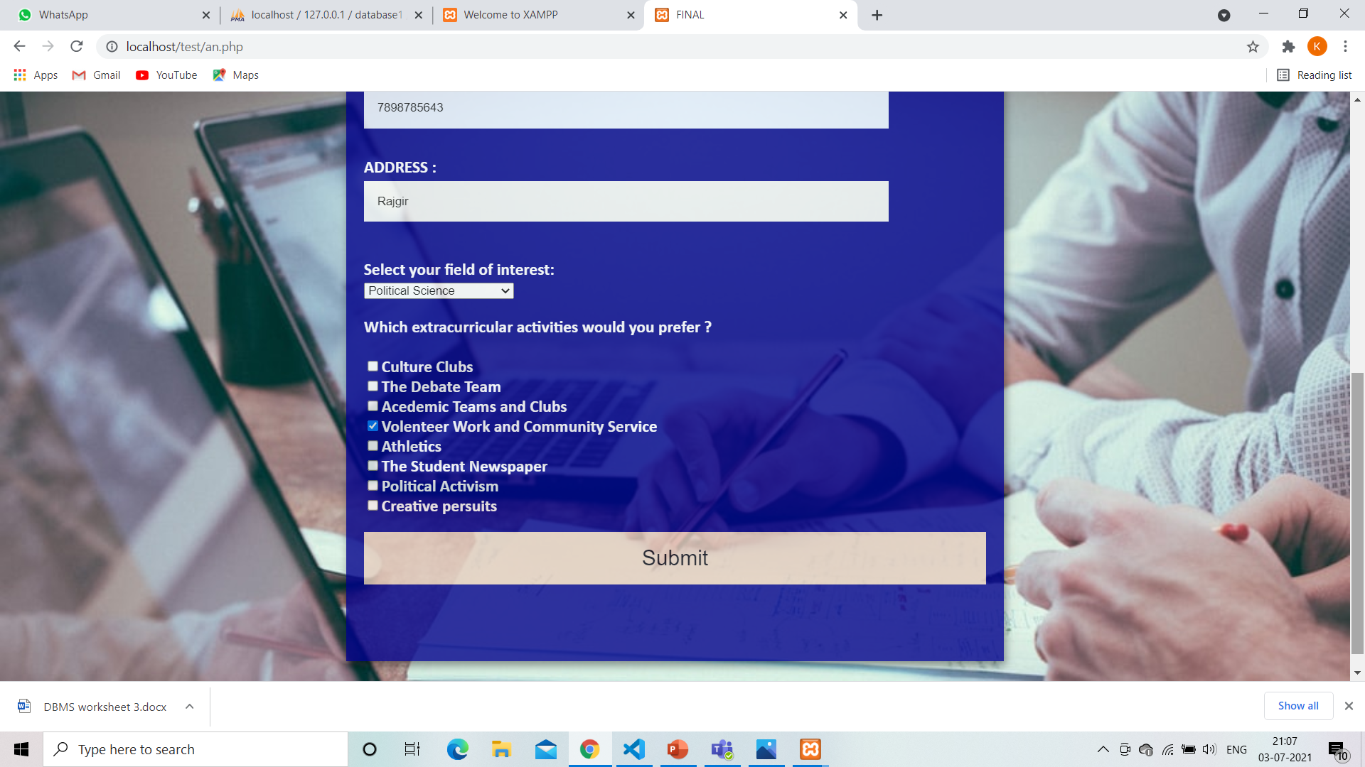

Slide 16
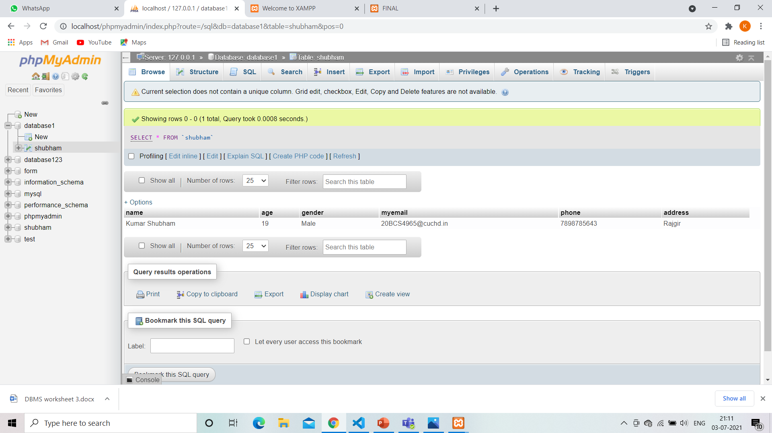

Slide 17
References
https://youtu.be/qm4Eih_2p-M
https://www.w3schools.com/css/css_background.asp
https://youtu.be/qm4Eih_2p-M

Slide 18
Group members details
Kumar Shubham (20BCS4965)
Chetan Kumar (20BCS4906)
Aditya Raj (20BCS4955)
Shaswat Rai (20BCS4905)

